Slide 1


Daniel Ramirez
13-Nov-2022

Slide 2

Outline
Executive Summary
Introduction
Methodology
Results
Conclusion
Appendix

Slide 3
Executive Summary
For this development we have utilized API and webscraping to collect data about the Space X launching results, then we perform an exploratory and visual analysis of said data using SQL and Folium to generate an interactive dashboard
Then we perform a predictive analysis using four classification models to help determine which decisions will have a better outcome.
At the end of the work we have determined that one site have an outstanding success landing of 79%, that a VLEO orbit has the most recent success and support, that the best model to analyze these data are the decision tree and that the heavier payload mass have a greater possibility of being successful.

Slide 4
Introduction
Project background and context
In the beginning of a new space race, now fueled by Private Public Partnerships, the space exploration now requires more data than ever, the risks involved in the launch of each rocket makes that every piece of information very valuable and mistakes are carefully studied to create better and more efficient rockets.
Problems you want to find answers
In this context, we’re going to evaluate the data containing information about the recent launchings of Space X to determine the best conditions of a successful launching to replicate them in our own company.

Slide 5

Section 1

Slide 6
Methodology
Executive Summary
Data collection methodology:
Data was obtained form two sources SpaceX API and Wikipedia webscraping
Perform data wrangling
We deal with missing values, normalize and summarize the data
Perform exploratory data analysis (EDA) using visualization and SQL
Perform interactive visual analytics using Folium and Plotly Dash
Perform predictive analysis using classification models
We use and evaluate four classification models

Slide 7
Data Collection
The data were collected from the Space X API ("https://api.spacexdata.com/v4/launches/past") and Wikipedia (https://en.wikipedia.org/wiki/List_of_Falcon\_9\_and_Falcon_Heavy_launches)

Slide 8
Data Collection – SpaceX API
Space X offers a public API where data can be obtained and used to make tests.
The data was used according to the next flowchart
Source code: https://github.com/dramirezfigueredo/Python-Data-Science-Capstone/blob/master/jupyter-labs-spacex-data-collection-api.ipynb
Note: if the notebook is not opening at first, please refresh the page.
Request and parse the SpaceX launch data using the GET request
Filter the dataframe to only include Falcon 9 launches
Dealing with Missing Values

Slide 9
collect Falcon 9 historical launch records from a Wikipedia page titled List of Falcon 9 and Falcon Heavy launches
Data Collection - Scraping
We collect Falcon 9 historical launch records from a Wikipedia page titled List of Falcon 9 and Falcon Heavy launches using websacrpping
Source code: https://github.com/dramirezfigueredo/Python-Data-Science-Capstone/blob/master/jupyter-labs-webscraping.ipynb
Request the Falcon9 Launch Wiki page from its URL
Extract all column/variable names from the HTML table header
Create a data frame by parsing the launch HTML tables

Slide 10
Data Wrangling
We perform some Exploratory Data Analysis (EDA) to find some patterns in the data and determine what would be the label for training supervised models
Then we summarized information about launches, orbits, occurrence missions and the outcome of each mission.
The process is shown a continuation:
Source code: https://github.com/dramirezfigueredo/Python-Data-Science-Capstone/blob/master/labs-jupyter-spacex-Data%20wrangling.ipynb
Calculate the number of launches on each site
Calculate the number and occurrence of each orbit
Calculate the number and occurence of mission outcome per orbit type
Create a landing outcome label from Outcome column

Slide 11
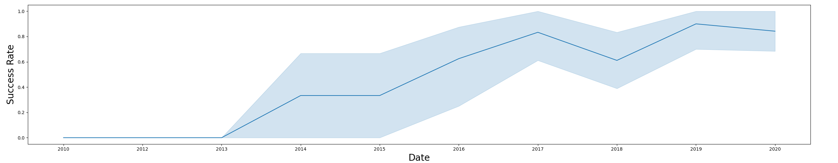
EDA with Data Visualization
To explore data, we used scatterplots, barplots and a line graph to explain the different relationships between Flight Number and Launch Site, Flight Number and Orbit type, Payload and Launch Site, Payload and Orbit type, the success rate of each orbit type and the launch success yearly trend
Source code: https://github.com/dramirezfigueredo/Python-Data-Science-Capstone/blob/master/module_2_jupyter-labs-eda-dataviz.ipynb.jupyterlite.ipynb

Slide 12
EDA with SQL
The following the SQL queries were performed:
Display the names of the unique launch sites in the space mission
Display 5 records where launch sites begin with the string 'CCA'
Display the total payload mass carried by boosters launched by NASA (CRS)
Display average payload mass carried by booster version F9 v1.1
List the date when the first successful landing outcome in ground pad was achieved.
List the names of the boosters which have success in drone ship and have payload mass greater than 4000 but less than 6000
List the total number of successful and failure mission outcomes
List the names of the booster versions which have carried the maximum payload mass. Use a subquery
List the records which will display the month names, failure landing outcomes in drone ship ,booster versions, launch site for the months in year 2015.
Rank the count of successful landing outcomes between the date 04-06-2010 and 20-03-2017 in descending order.
Source code: https://github.com/dramirezfigueredo/Python-Data-Science-Capstone/blob/master/jupyter-labs-eda-sql-coursera_sqllite.ipynb

Slide 13
Build an Interactive Map with Folium
Markers, circles and lines were created and added to a folium map to indicate the distance of landmarks to the launching sites, this is useful to determine the potential impact over communities in case of failure and at the same time, the minimum distance at which a successful launching affects the community.
Marker clusters were used to indicate the launching sites and their performance.
Source code: https://github.com/dramirezfigueredo/Python-Data-Science-Capstone/blob/master/module_3_lab_jupyter_launch_site_location.jupyterlite.ipynb

Slide 14
Build a Dashboard with Plotly Dash
We have added a Success Launches by site, a payload range and a relation between the booster version, the payload mass and the success of the launching to the dashboard
This will facilitate identify the success of a launching starting with the launching site and the mass of the rocket
Source code: https://github.com/dramirezfigueredo/Python-Data-Science-Capstone/blob/master/spacex_dash_app.py

Slide 15
Predictive Analysis (Classification)
We compared four classification models: Logistic regression, SVC, decision tree and KNN
Source code: https://github.com/dramirezfigueredo/Python-Data-Science-Capstone/blob/master/module_4_SpaceX_Machine_Learning_Prediction_Part_5.jupyterlite.ipynb
Perform exploratory Data Analysis and determine Training Labels
Find best Hyperparameter for SVM, Classification Trees and Logistic Regression
Find the method performs best using test data

Slide 16
Results
The payload mass launches over 9000 Kg have a great possibility of success.
The VLEO orbits have gotten better with time and are being used more often, opening a business possibility
With each launching the possibility of success is increased.
Decision tree shows the strongest predictive analysis between the models utilized with an accuracy of 87%

Slide 17

Section 2

Slide 18
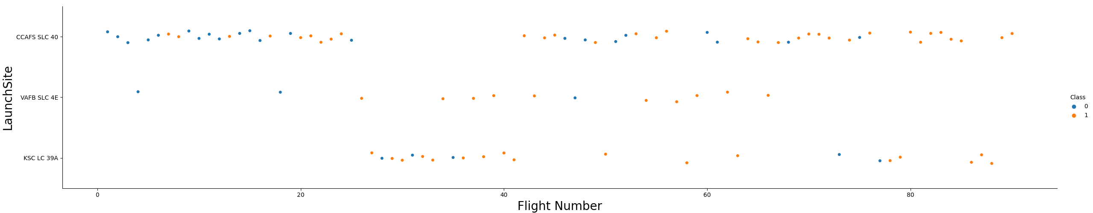
Flight Number vs. Launch Site
It’s possible to say that the launching success has improved with time, CCAFS SLC 40 is not only the site with the most successful landings but also the site that where the majority of launches has occurred, This could be explained by an experienced crew and is getting better results with time..
VAFB SLC 4E has the second place in successful launches but has passed a while since the last launching occurred in the site and KSC LC 39A is the third more successful launching site.

Slide 19
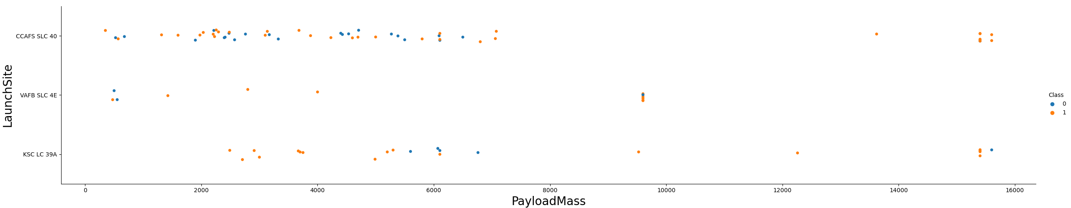
Payload vs. Launch Site
Rockets with a payload mass over 9.000 Kg have a great success rate.
Also, is notable that looks like you can only send rockets over 10.000 Kg from KSC LC 39A and CCAFS SLC 40, which could explain why VAFB SLC 4E has not been used in a while.

Slide 20
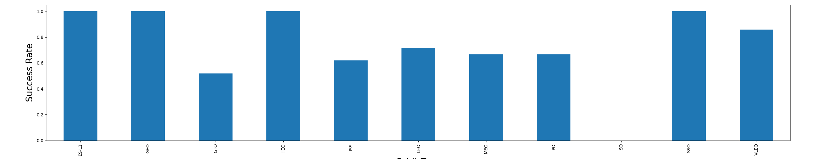
Success Rate vs. Orbit Type
Rockets that follows the highlly elliptycal orbit (HEO), the geostationary orbit (GEO) and the sun synchronous orbit (SSO), and the ES-L1 (Lagragian Point) have an excellent performance
Low and medium orbits are not as succesful; but the very low earth orbit (VLEO) rockets have a great performance.

Slide 21
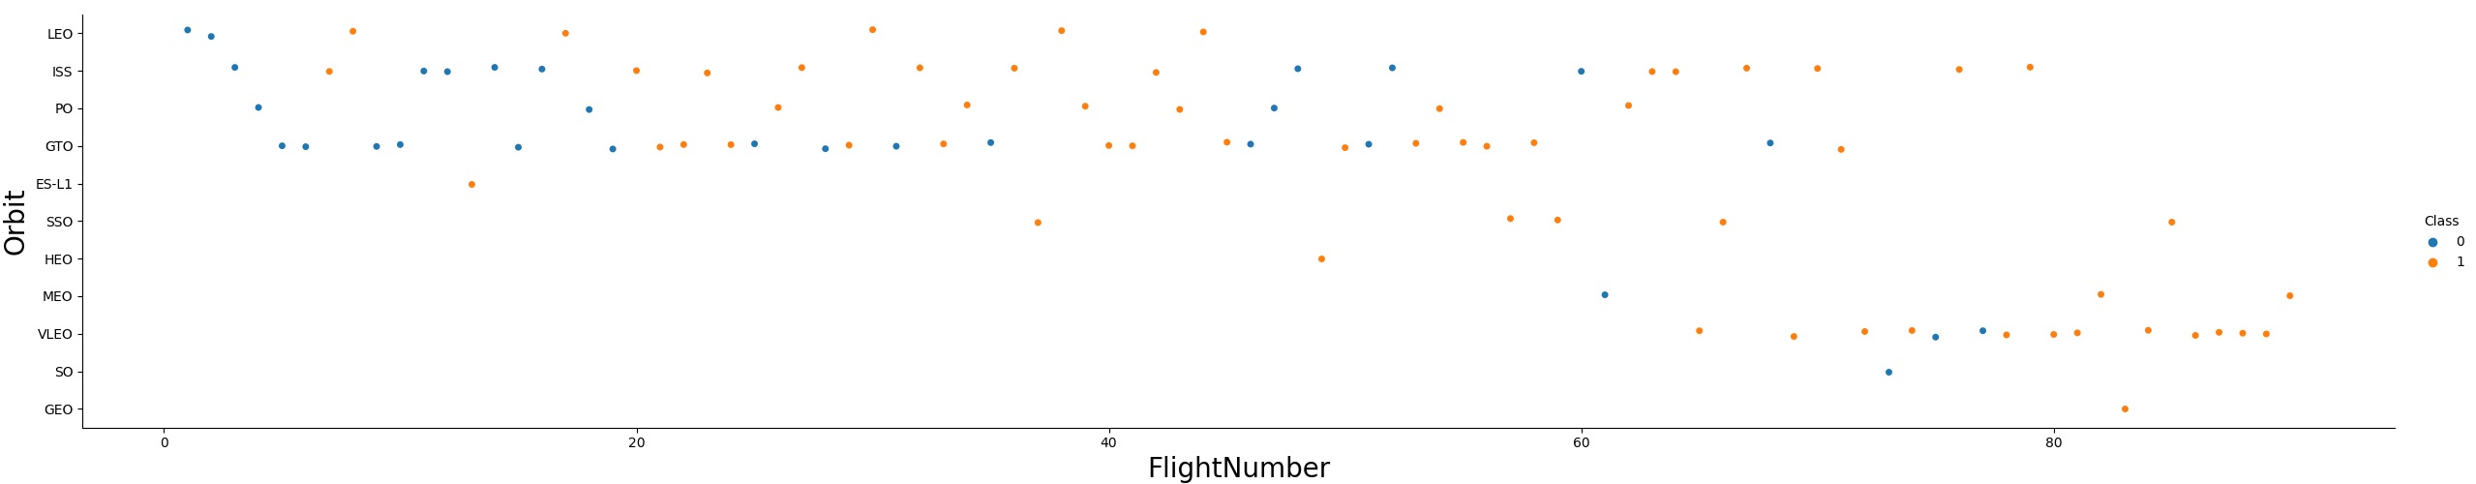
Flight Number vs. Orbit Type
There is a recent interest in the use of the Very Low Earth Orbits (VLEO), so there could be a business opportunity in that field.
As we have already seen, with more flights the success rate has increased.

Slide 22
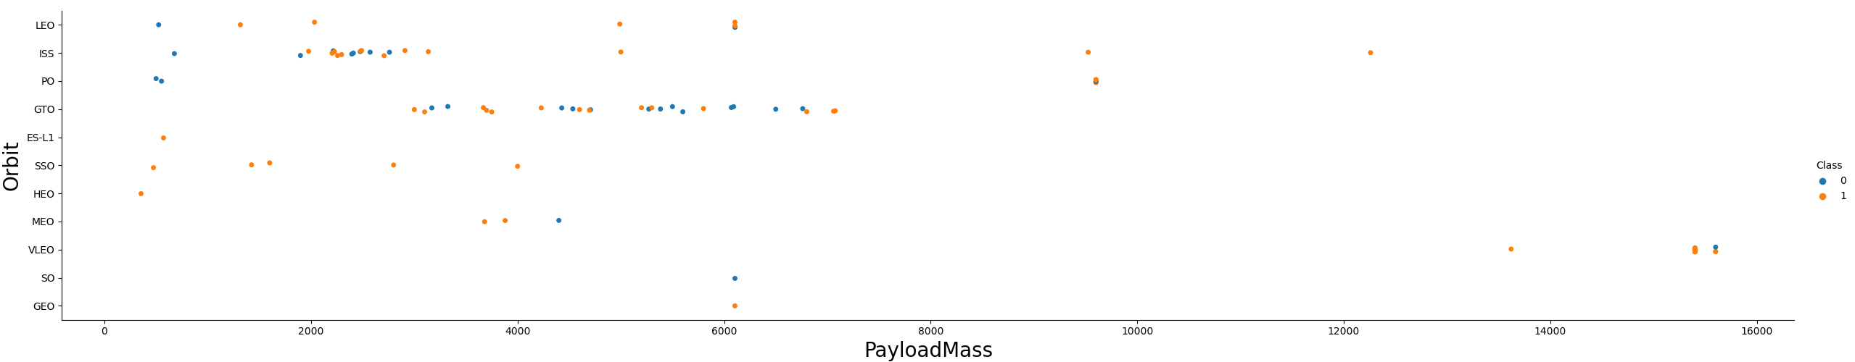
Payload vs. Orbit Type
A rocket with a Payload Mass over 8.000 Kg has a great chance of success, independient of the orbit that would follow.
The Very low Earth Orbit (VLEO) that has received a recent interest allows the launching of this heavy objects.

Slide 23
Launch Success Yearly Trend
With more time, the results have been better, and now the succes rate overall is over 80%

Slide 24
All Launch Site Names
Launch Site
CCAFS LC-40
VAFB SLC-4E
KSC LC-39A
CCAFS SLC-40
There are four launch sites.
We used a query that takes every individual launch site from the data.

Slide 25
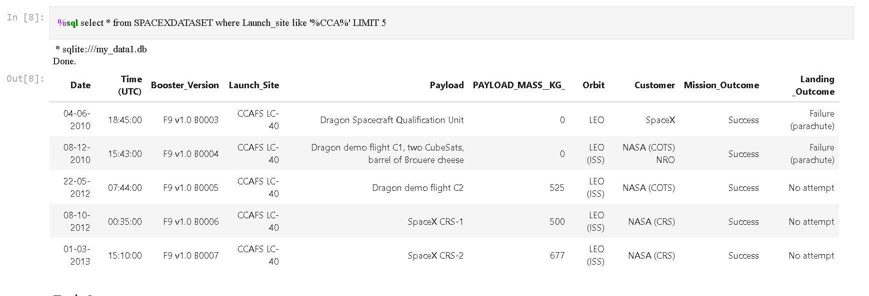
Launch Site Names Begin with 'CCA'
We can see five examples of launches from the site that begins with “CCA”.

Slide 26
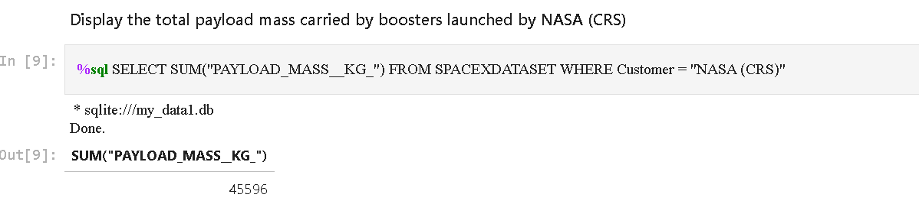
Total Payload Mass
All the boosters where the costumer has been NASA weight 45.596 Kg

Slide 27
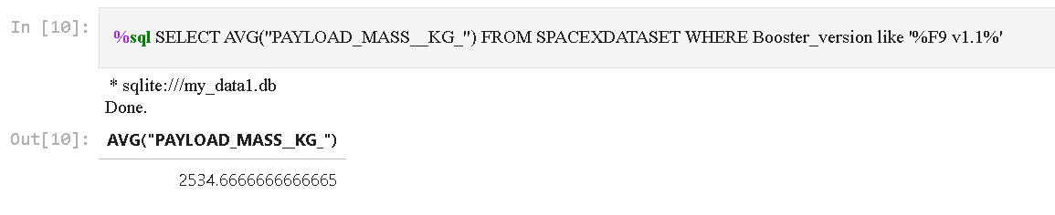
Average Payload Mass by F9 v1.1
The average payload mass carried by booster version F9 v1.1 is 2534, 66 Kg

Slide 28
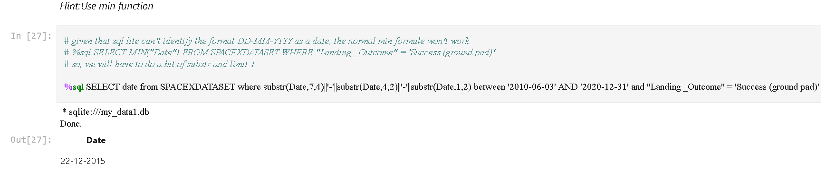
First Successful Ground Landing Date
Normally, you would use the select min date query, but I have been using the skill network notebook and sql lite doesn’t recognize the date format in the .csv file that uses, so I had to do a bit more but the date of the first successful landing in ground pad is 22-12-2015

Slide 29
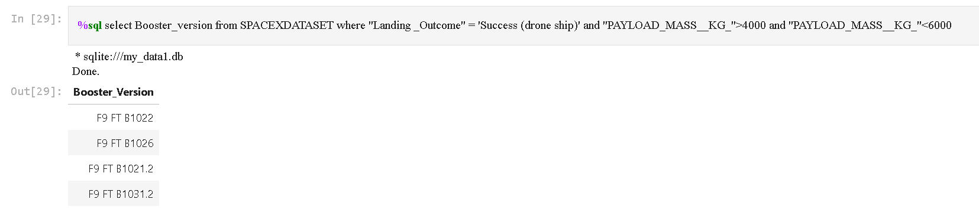
Successful Drone Ship Landing with Payload between 4000 and 6000
There are four boosters which have successfully landed on drone ship and had payload mass greater than 4000 but less than 6000

Slide 30
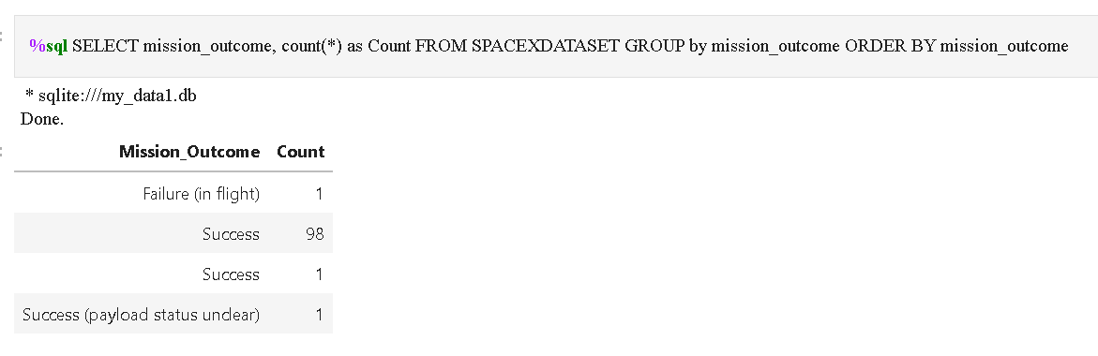
Total Number of Successful and Failure Mission Outcomes
There have been only one mission that has been classified as failure in the whole process, the other 100 have been successful in fulfilling their objectives.

Slide 31
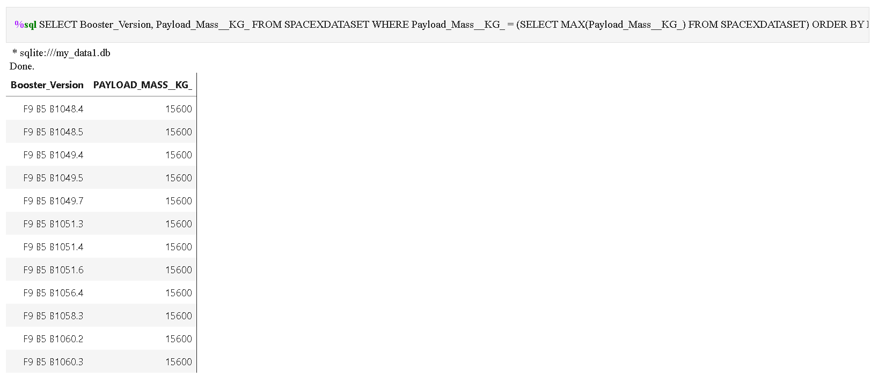
Boosters Carried Maximum Payload
Twelve boosters have carried the maximum payload mass: 15600 Kg

Slide 32
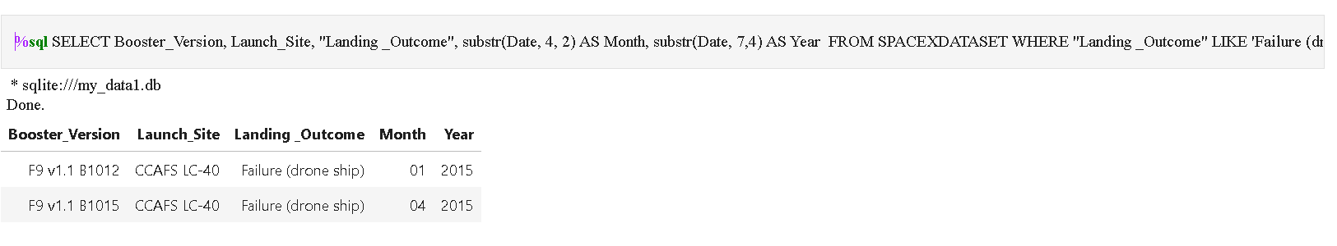
2015 Launch Records
There are two boosters that have failed their landing in a drone ship in 2015.

Slide 33
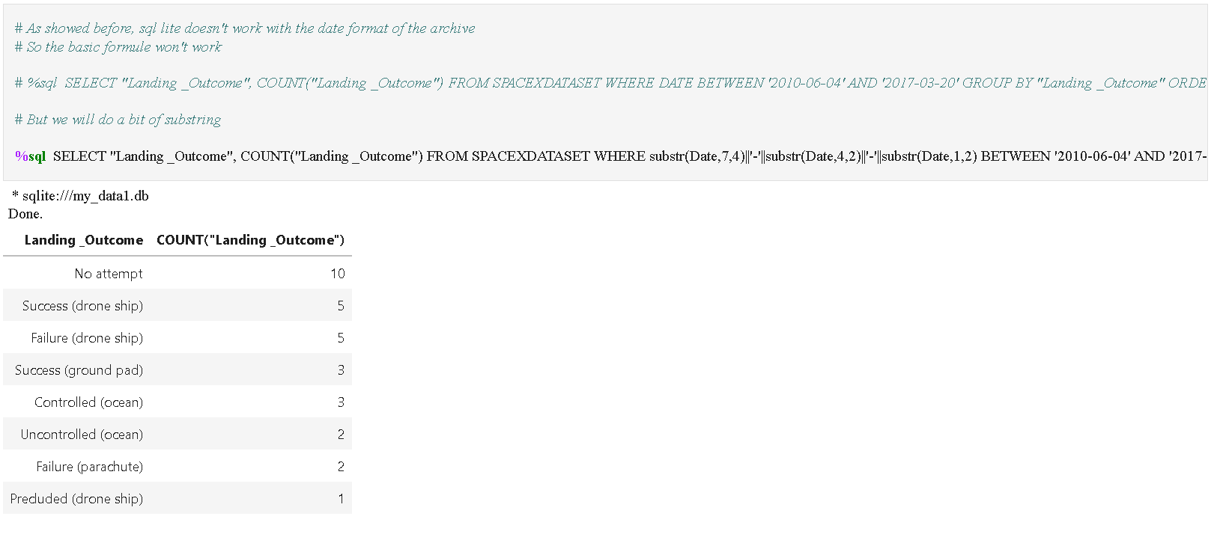
Rank Landing Outcomes Between 2010-06-04 and 2017-03-20
Between 2010-06-04 and 2017-03-20, there were ten (10) no attempt at landing, followed by five (5) success of landing into a drone ship and five (5) failure at landing into a drone ship

Slide 34

Section 3

Slide 35
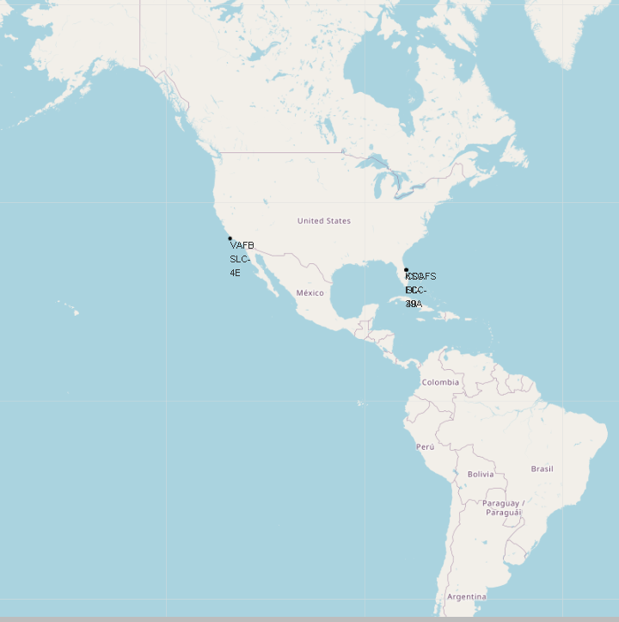
Location of lauching sites
The location sites are near the coastline, to reduce risks related to populate areas and facilitate the retrieving of ships fallen to sea.
They are near the equator to have a stable climate through the year.
At the same time they are located in USA to take advantage of the existent infrastructure.

Slide 36
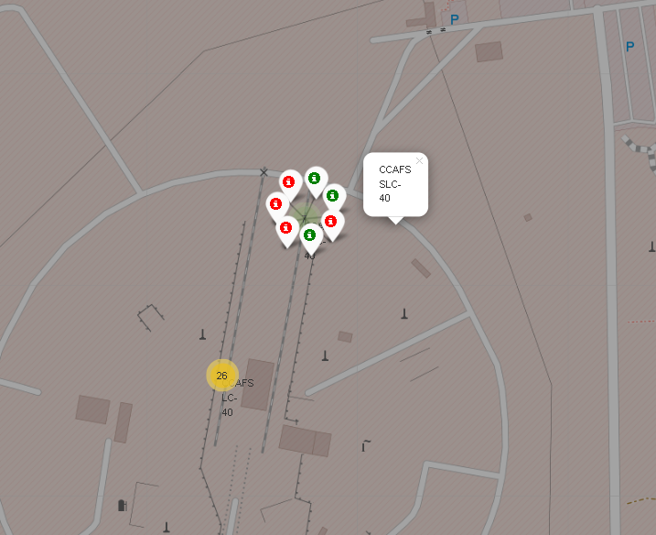
Launch outcomes in CCAFS SLC-40
In the map we can see that from the Cape Canaveral Space Launch Complex 40 (CCAFS SLC-40) have been launched three successful outcomes and four failed outcomes in seven missions.
At south of the complex you can see the Cape Canaveral Launch Complex 40 (CCAFS LC-40) from where have been launched 26 missions.

Slide 37
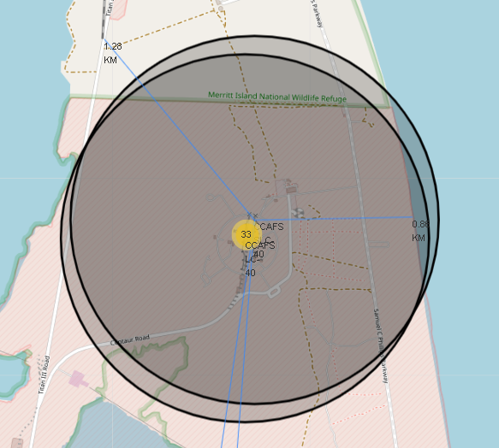
Landmarks near CCAFS SLC-40
The Cape Canaveral Space Launch Complex 40 (CCAFS SLC-40) is at 1,28 Km from a railway and at 840m from the coastline.

Slide 38
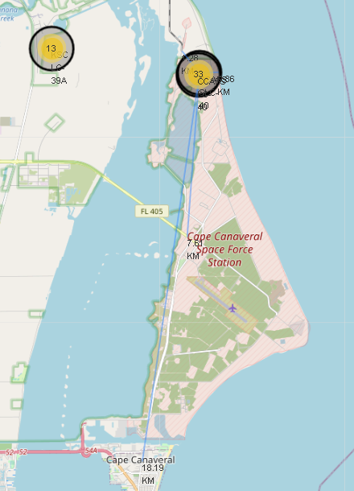
Landmarks near CCAFS SLC-40
The Cape Canaveral Space Launch Complex 40 (CCAFS SLC-40) is at 7,61 Km from a highway and at 18.19 Km from Cape Canaveral.

Slide 39

Section 4

Slide 40
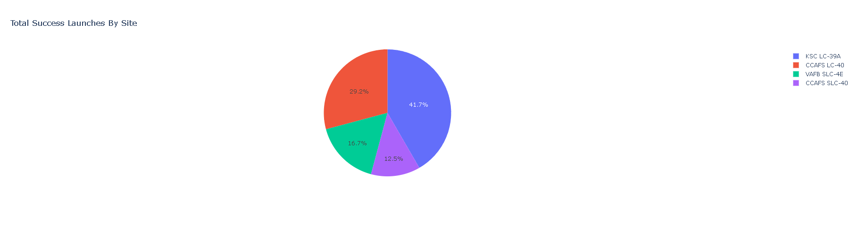
Success Launches by site
KSC LC 39A accounts for the 41,2% of the successful launches, followed by the Cape Canaveral Launch Complex 40 (CCAFS LC-40) with the 29,2% of the successful missions

Slide 41
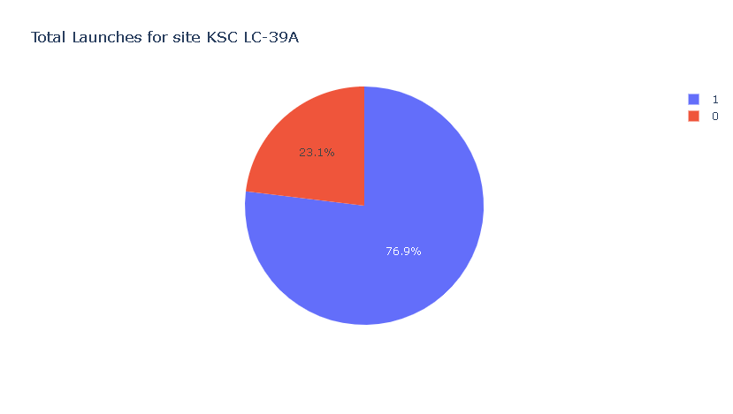
KSC LC 39A Launches
With 10 of 13 missions successfully landing (76,9%) KSC LC 39A is the most adequate site to attempt a launching.

Slide 42
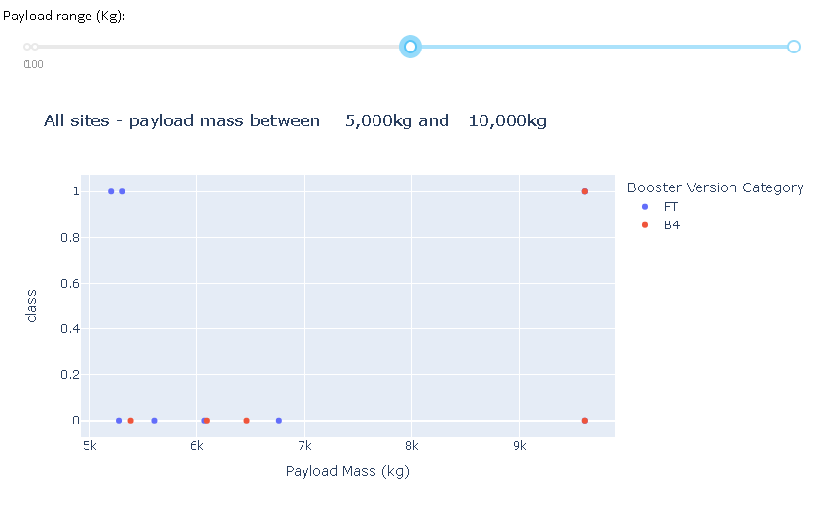
The Booster FT vs the Booster B4
Between 5,000 Kg and 10,000 Kg there are just two booster versions: the FT and the B4.
The FT has shown some success around 5000-5500 Kg, but in every try over 6000 Kg has failed.
Meanwhile, the B4 is the opposite, his best performance was near the 10,000 Kg but in lesser weight has failed.

Slide 43

Section 5

Slide 44
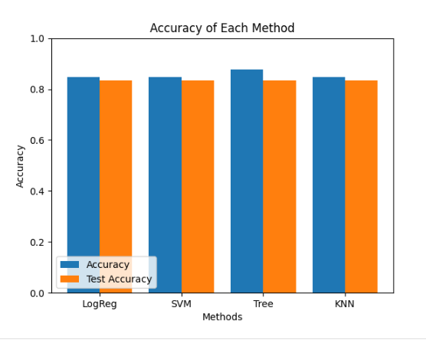
Classification Accuracy
Four models were tested: KNN, Decision Tree, SVC and Logistic Regression.
According to the graph, all models are adequate but Decision Tree is stronger in its results.

Slide 45
Confusion Matrix
For some reason, the confusion matrix is not working in the Skill Network Labs at the moment.

Slide 46
Conclusions
The highest successful landing is KSC LC 39A
If the rocket is over 9000 Kg, the landing could be a success
The best opportunity at the moment is attempt a launching into the (VLEO) Orbit
As time passes is safer the attempt on successful landing
…

Slide 47
Appendix
Note: This project is different, I have used only the skill labs notebooks so all the databases are into their fixed links.
The project content are the seven skill labs modules and the spacex_dash_app.
Everything is included in my github account according to the instructions of the course and I hope the best.

Slide 48


